Slide 1

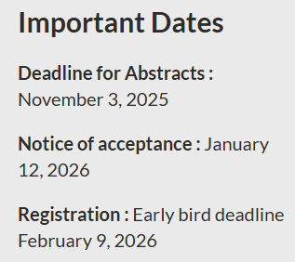
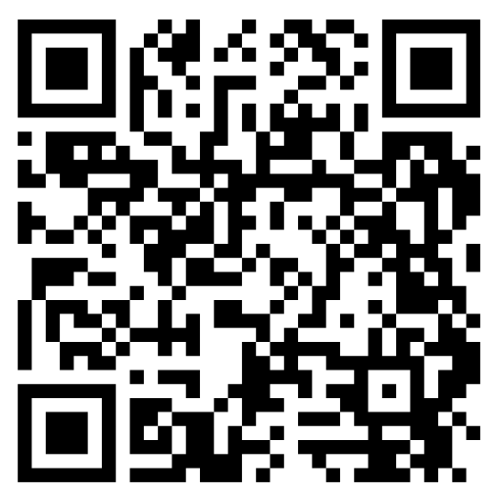
Please join us for Operando VIII in Asilomar, CA from May 10-14, 2026!
Objective is to bring researchers together to discuss the progress of operando methodologies, i.e. characterization of functional materials in their working state.
Please visit our website to learn more.
Scan the QR code, or visit the following link.
https://events.slac.stanford.edu/operando-viii

